Slide 1
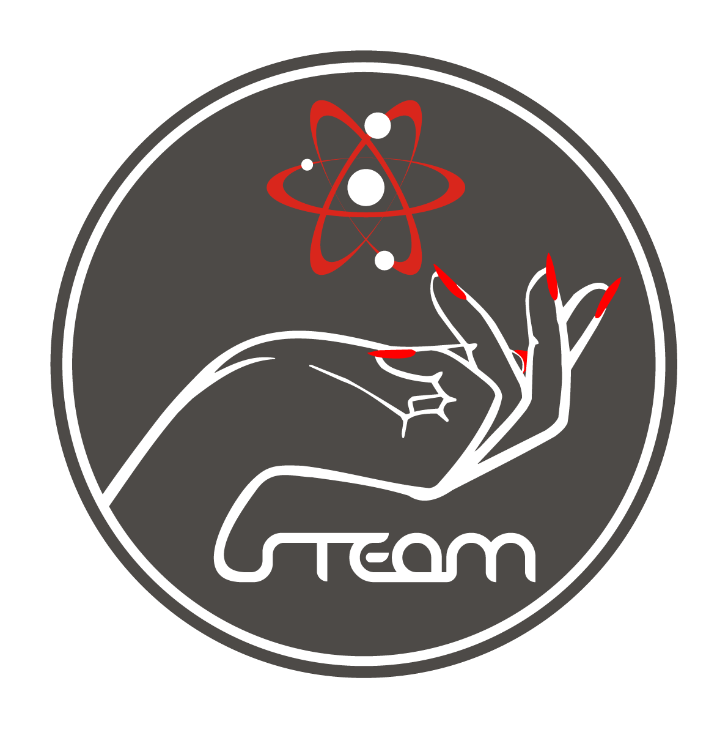
Galaxy of women
FULL STEAM AHEAD!

Slide 2
iNTRODUCTION
In Physics, Albert Einstein and Isaac Newton; in Chemistry, Melvin Calvin; in Biology, Charles Darwin; in Maths, Blaise Pascal…

Slide 3
You can name a lot of male scientists in the history of mankind, but what about women in Science?

Slide 4
Now, we’re going to discover together some of the most amazing women in the history of Europe of the past and the present. Women who have dedicated all their lives to Science.

Slide 5
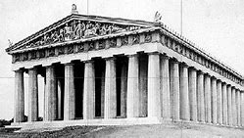
Ancient greece
The study of natural philosophy in ancient Greece was open to women. Recorded examples include Aglaonike, who predicted eclipses; and Theano, mathematician and physician, who was a pupil of Pythagoras.

Slide 6
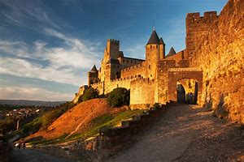
Medieval europe
Convents were an important place of education for women during this period. The German abbess Hildegard of Bingen (1098–1179 A.D) was a famous philosopher and botanists, known for her prolific writings which include treatments of various scientific subjects, like medicine, botany and natural history.

Slide 7
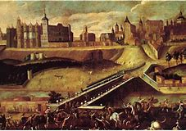
SixteenTH and seventeenTH century
The most famous female astronomer of the time was German Maria Winkelmann. Winkelmann's problems with the Berlin Academy reflect the obstacles women faced in being accepted in scientific work, which was considered to be chiefly for men. No woman was invited to either the Royal Society of London nor the French Academy of Sciences until the 20th century.

Slide 8
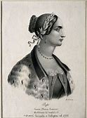
EIGHTEENTH CENTURY
Laura Maria Caterina Bassi was an Italian physicist and academic. She received a doctoral degree in Philosophy from the University of Bologna in May 1732. She was the first woman to earn a professorship in Physics at a university.

Slide 9
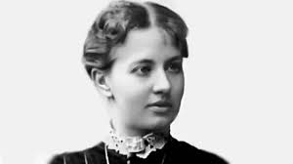
MARIE SOPHIE GERMAIN
Sophie Germain (1776 – 1831) was a mathematician, physicist and French philosopher. She was a pioneer of the elasticity theory and she made important contributions to the number theory.

Slide 10
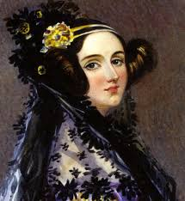
Early Nineteenth century ADA LOVELACE (London 1815 – 1852)
She is considered the first computer programmer in history. She worked on the calculator called analytical machine. The US Department of Defense called "Ada" a language programmer in her honor.

Slide 11
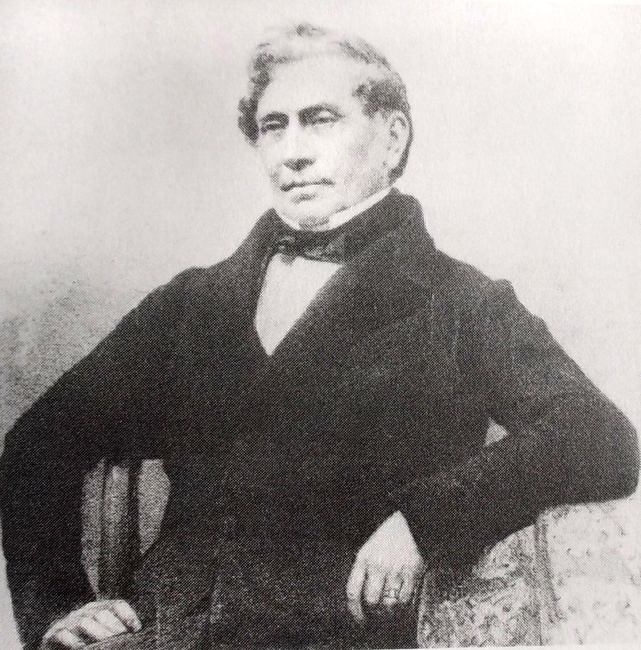
Late nineteenth century
James Barry became the first British woman to gain a medical qualification in 1812, passing as a man all her adult life. Barry was born Margaret Ann Bulkley.

Slide 12
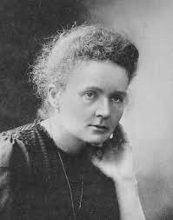
Marie curie
She was born in 1867 in Poland and died in 1934.
She was one of the pioneer scientist woman
in the study of radiation.
She discovered the radio and the polonium.
She was the first woman to receive two Nobel Prizes in different categories: Physics (1903) and Chemistry (1911)
His eldest daughter, Irène Curie-Joliot, also dedicated her life to Science and, like her mother, won a Nobel Prize in Chemistry (1935) for her research.

Slide 13
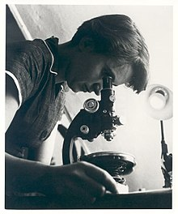
TwentIEth century: ROSALIND FRANKLIN
Rosalind Elsie Franklin (London, 1920-1958) was an English chemist and crystallographer, responsible for important contributions to the understanding of DNA structure.

Slide 14
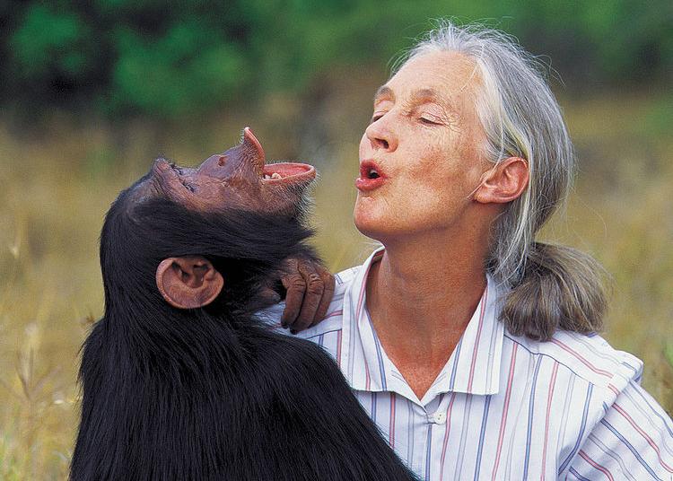
Valerie jane goodall
Valerie Jane Morris-Goodall was born in London in 1934. She studied the use of tools in chimpanzees. In 2003, she won the Price Príncipe De Asturias because of her scientific and technological investigation.

Slide 15
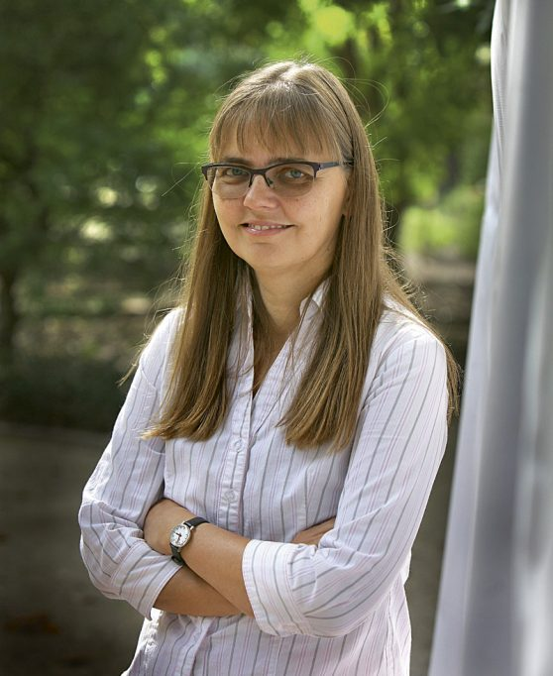
Hanna kokko
Hanna Kokko (born 1971) is a scientist, working in the field of evolution and ecology. She was a Professor of Evolutionary Biology at Helsinki University, Finland. She is currently Professor in Evolutionary Ecology at the University of Zürich.

Slide 16
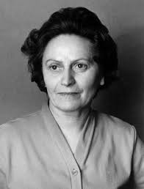
L´UDMILA PAJDUSÁKOVÁ
She was a Slovak astronomer and physicist (1916-1979).
She was director of the Astronomical Institute of the Slovak Academy of Sciences.
She discovered five comets and three of them bear her name.

Slide 17
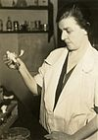
AIME MäEMETS
Aime Mäemets (1930-1996) was an Estonian botanist and hydrobiologist. She conducted considerable research into Lake Peipsi and was known for her study of Macrophytes. She finished University of Tartu in 1954. From 1961 to 1996 she worked in Estonian Institute of Zoology and Botany and was a well-known specialist of Potamogetonaceae plants.

Slide 18
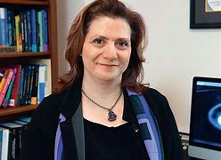
Vassiliki Kalogera
Vassiliki Kalogera (born in 1975) is a Greek astrophysicist. She is a professor at Northwestern University and the Director of the Center for Interdisciplinary Exploration and Research in Astrophysics (CIERA).
Kalogera is a leading theorist in the study of gravitational waves, the emission of X-rays from compact binary objects and the coalescence of neutron-star binaries.

Slide 19
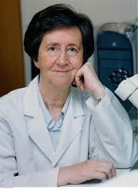
Margarita salas
She was born in 1938 in Spain and she died in November 2019.
She worked for three years with Severo Ochoa at the University of New York, focusing her research in the field of molecular biology.
One of her main contributions to science was the Discovery of DNA polymerase, which is responsible for DNA replication.

Slide 20
CONCLUSION
These powerful women in Science never backed down from pursuing their passions, and those enduring legacies continue to move other women into the STEM fields.

Slide 21
“Don't let anyone rob you of your imagination, your creativity, or your curiosity. It's your place in the world; it's your life. Go on and do all you can with it, and make it the life you want to live.” - Mae Jemison, first African American woman astronaut in space

Slide 22
THANK YOU
FOR
YOUR ATTENTION

Slide 23
THE END
FULL STEAM AHEAD!

