Slide 1
Healthy lifetyle and physical activity
By Zofia Lewandowka

Slide 2
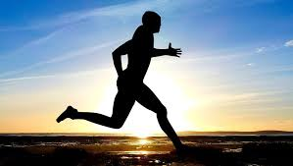
Physical activity , what is it ?
Physical activity, or physical activity, to the scope of work, from the search for everyone, to use in everyday life.

Slide 3
The role of physical activity
The results of many scientific studies prove the field of view of the electric field in human life is extremely important. The benefits that result from the daily diagnostics of movement are systemic and individual body systems. It has been proven that regular physical exertion on the way to the immune street, for example, reducing the number of viral infections, especially in the autumn and winter periods, and thus less medications

Slide 4
Healthy lifestyle = physical activity
Physical activity is conducive to improving health and, in addition to diet, is the basis of a healthy lifestyle. Exercise helps to oxygenate the body better and improve its efficiency. It is also a great way to deal with stress, because physical activity has a positive effect on our mental state

Slide 5
Physical activity is the basis of health
Doing regular exercise - walking, cycling, rollerblading, jogging - prevents the build-up of body fat and obesity. During physical exercise, the blood flows faster in the blood vessels, thanks to which the tissues are better supplied with blood and oxygenated. In addition, the hormones of happiness are released - endorphins and serotonin, which improve the mood. If you do not have time to exercise regularly, you should increase your activity while on vacation. Instead of lounging all day on the beach, it is worth going to the mountains. During the climbing, all muscle groups work and the body is shaped.

Slide 6
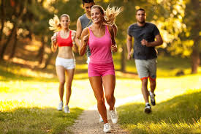

Slide 7
The benefits of physical activity
Reducing the risk of obesity. ...
Reducing the risk of heart disease. ...
Diabetes. ...
Reduced risk of cancer. ...
Muscles and bones. ...
Mental health. ...
How much should you practice ...
Quality of life and its length

Slide 8
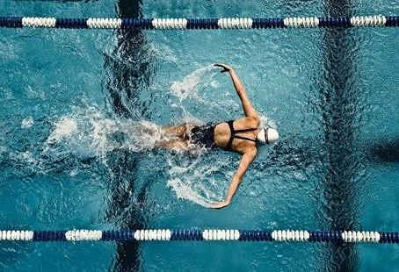
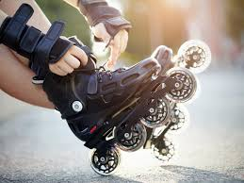
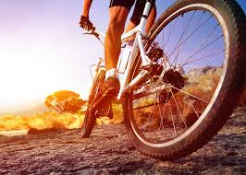

Slide 9
REMEMBER !!! Movement is health

