Slide 1
Museum of soap and the history of dirt
In Poland

Slide 2
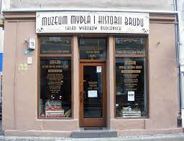
About the museum itself
The museum is located in Bydgoszcz, you will learn the whole history of dirt throughout the years

Slide 3
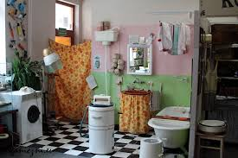
What are we going to do?
In the museum, you can make your own soap and see what the bathrooms looked like several decades ago.

Slide 4
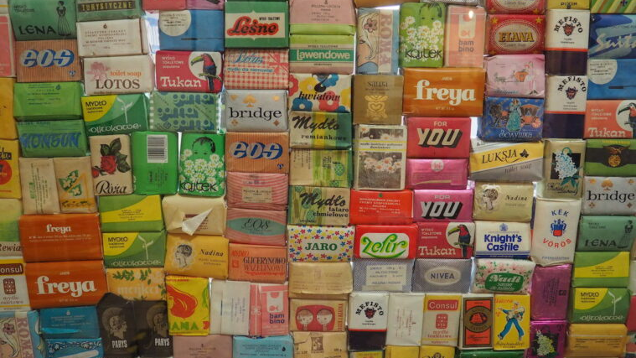
History
The facility was opened on September 1, 2012 on the initiative of Daria Kieraszewicz and Adam Bujny. It refers to the tradition of the chemical industry in Bydgoszcz, developed in the 19th century, including the production of soap, exported from here to many European countries.

