Slide 1
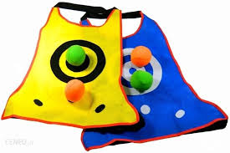
Dodgeball

Slide 2
Dodgeball - a multiplayer sports game, intended mainly for children. It is often mistakenly referred to as "mallet" (there are no "dams" in the mallet).
To play, you need a pitch or a large rectangle (approx. 100 square meters) divided into two equal parts and a ball (maybe for volleyball).

Slide 3
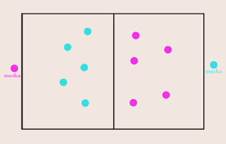
The rules
Two teams compete in the game (with the same number of players, depending on the size of the playing field, there may be from 3 to 20 of them in each team). "Mothers" cannot be beaten.

Slide 4
The course of the game
The game consists in mutual "clumping", ie hitting the ball against people on the opposing team. The players cannot go beyond their own part of the field. A capture (or point) occurs when the thrown ball touches a player of the opposing team and lands. The tap does not count when the ball hits the ground. Catching the ball counts as a hit (unless the player catches the ball from his "mother"). Depending on the rules set, the game is played "for capture" or "for points". The first possibility means that the hit player leaves the field (then the team that loses all players loses). The point game is that each capture is counted as one point; the team with the most points wins. There are also other versions.

