Slide 1
Top 10 women in science
Made by: Julia Kowalska and Agnieszka Jakubiak

Slide 2
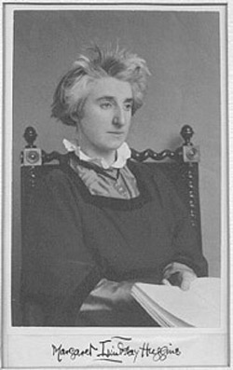
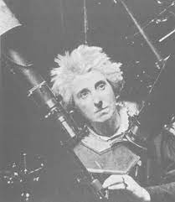
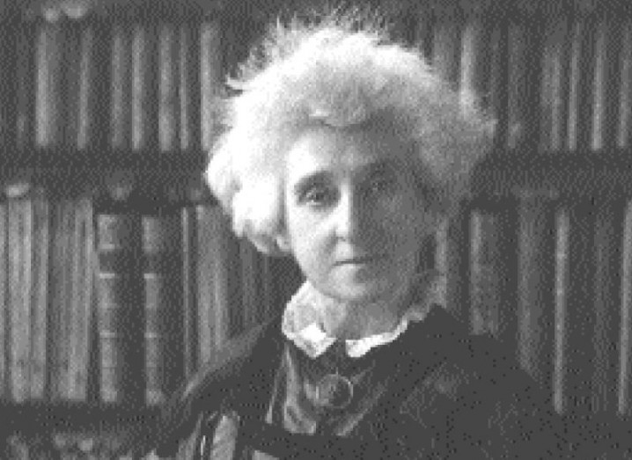
10. Margaret Lindsay Huggins

Slide 3
Margaret Lindsay Murray
Margaret Lindsay Murray was born in Dublin on 1848. She is best known for her work on the Orion Nebula. She concluded that there are two types of nebulae. Some are clusters of distant stars, but some, including Orion, are clouds of gas or dust, being heated by an unseen source within; they may even be stars in the process of being formed from clouds of dust. Margaret had taught herself spectroscopy, and had also become a skilled astro-photographer when she met astronomer William Huggins and married him in 1875.

Slide 4
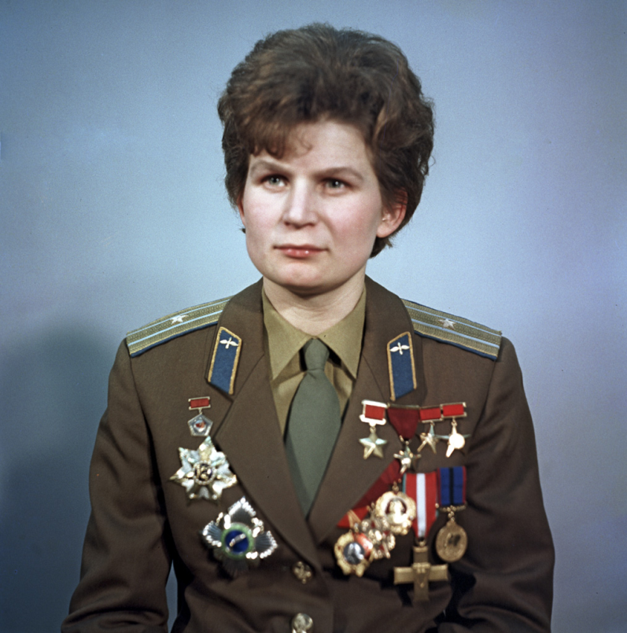
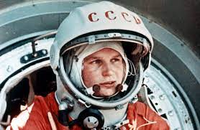
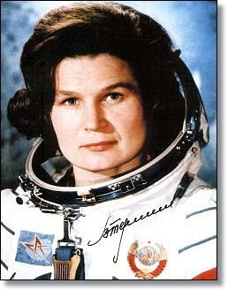
9. Valentina Tereshkova

Slide 5
Valentina Tereshkova
Valentina became interested in parachute jumping at an early age. It was her expertise in parachute jumping that led to her selection as a cosmonaut. Under the direction of Soviet premier Nikita Khrushchev, four women were selected to be trained for a special woman-in-space program. Of the four women selected, only Valentina Tereshkova completed a space mission.
In 1963, she took part in the legendary Vostok 6 flight, becoming the first woman in space.
She was born in 6th March 1937.

Slide 6
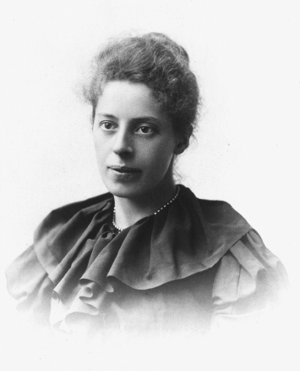
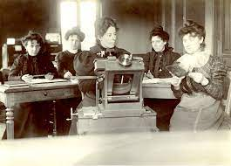
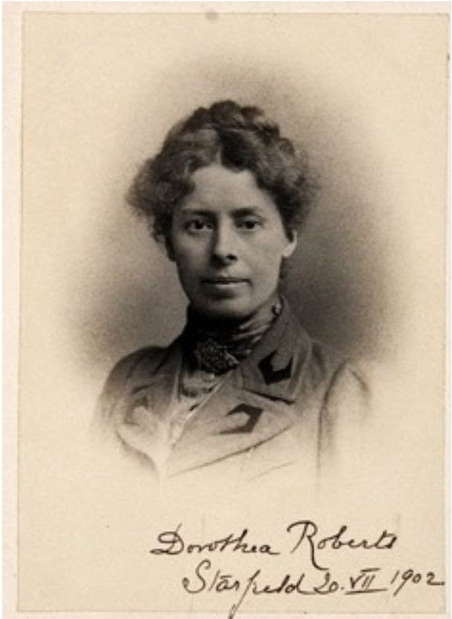
8. Dorothea Klumpke Roberts

Slide 7
Dorothea Klumpke Roberts
In 1889 she received an award from the Astronomical Society of France, and in 1893 she was the first woman to be appointed an officer of the French Academy of Sciences. On December 14, 1893, she was also the first woman to receive a doctorate in science from the Sorbonne for her research on Saturn's rings. Then she became the first female director of the Bureau of Measures of the Paris Observatory. On February 22, 1934, she was awarded the Legion of Honor. She then moved to San Francisco, where she died. She earmarked a portion of her fortune to help talented young astronomers, and established an award named after her.

Slide 8
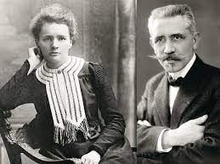
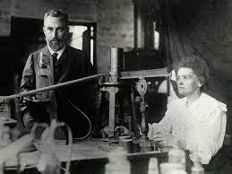
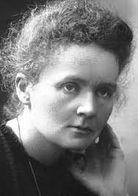
7. Maria Skłodowska-Curie

Slide 9
Maria Skłodowska-Curie
Polish physicist and chemist; she is the only woman to win two Nobel Prizes in Physics and Chemistry. In 1903 she received it together with her husband, Pierre. She was awarded the second Nobel Prize by herself in 1911. Thus, she became the first man to win Nobel Prize twice. She gained fame as a researcher of radioactivity and discoverer of two new elements - radium and polonium.

Slide 10
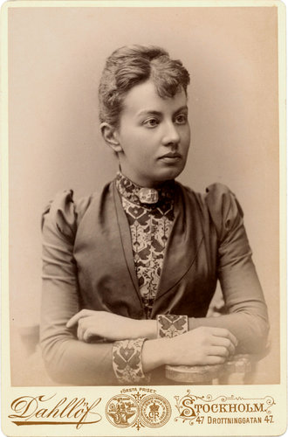
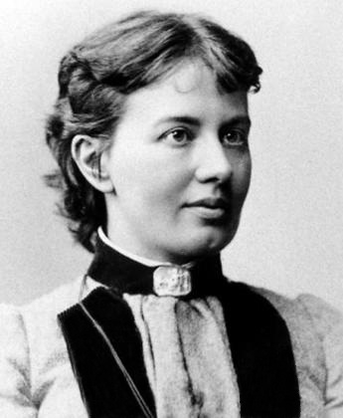
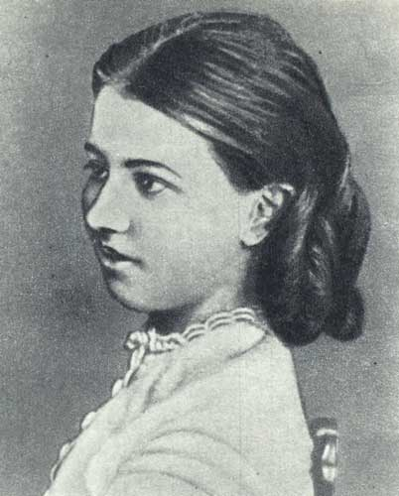
6. Sofia Kovalevskaya

Slide 11
Sofia Kovalevskaya
Sofia Kovalevskaya was a Russian born mathematician who made valuable contributions to the theory of differential equations. She finished her career in Sweden. By the spring of 1874, Kovalevskaya had completed three papers. Weierstrass deemed each of these worthy of a doctorate. The three papers were on Partial differential equations, Abelian integrals and Saturn's Rings. The first of these is a remarkable contribution which was published in Crelle's Journal in 1875. The paper on the reduction of abelian integrals to simpler elliptic integrals is of less importance but it consisted of a skilled series of manipulations which showed her complete command of Weierstrass's theory. Kovalevskaya's last published work was a short article Sur un théorème de M Bruns Ⓣ in which she gave a new, simpler proof of Bruns's theorem on a property of the potential function of a homogeneous body.

Slide 12
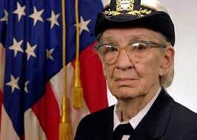
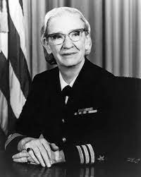
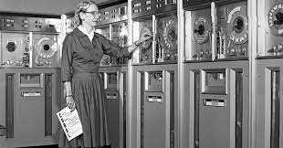
5. Grace Hopper

Slide 13
Grace Hopper
Adm. Dr. Grace Murray Hopper is known as the "mother of computers". During World War II, she joined the US Navy and was assigned to program the Mark I computer. She continued to work in computing after the war, leading the team that created the first computer language compiler, which led to the popular COBOL language. She also invented a compiler, a program that translates written language into computer code. She coined the term "bug" for computer program error and was a co-creator of COBOL, the first user-friendly business computer program.

Slide 14
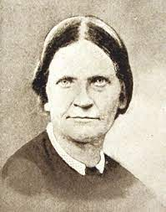
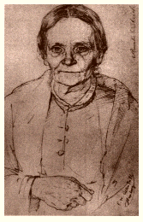
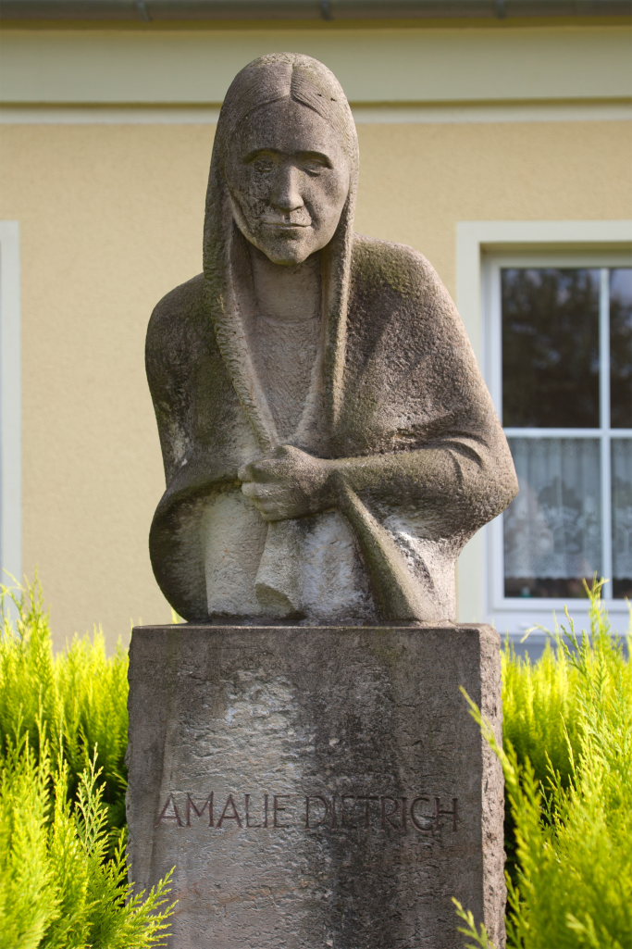
4. Amalie Dietrich

Slide 15
Amalie Dietrich
Dietrich traveled with her husband around Europe, collecting plants and selling medicinal products. Due to her husband's difficult nature, Dietrich soon broke up with him, keeping herself and her daughter from collecting botanical specimens. In recognition of her merits in the field of botany and zoology, many different species of animals and plants have been named in her honor, incl. Nortonia Amaliae and Odynerus Dietrichianus wasps, Endotrichella Dietrichiae moss or Amansia Dietrichiana and Sargassum Amaliae algae.

Slide 16
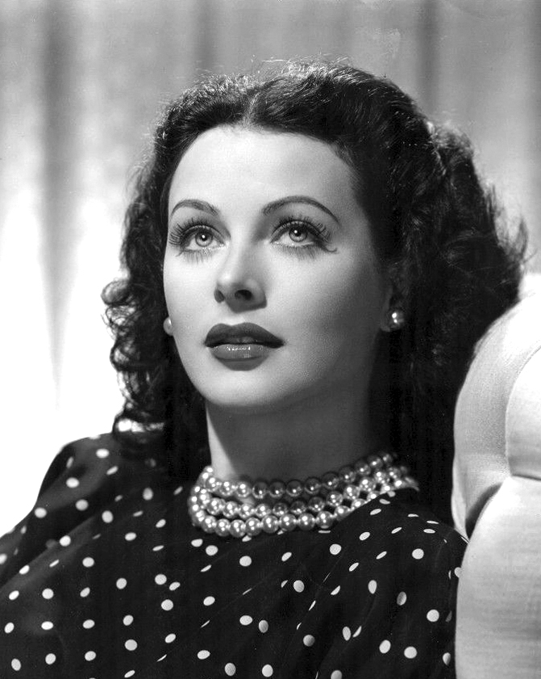
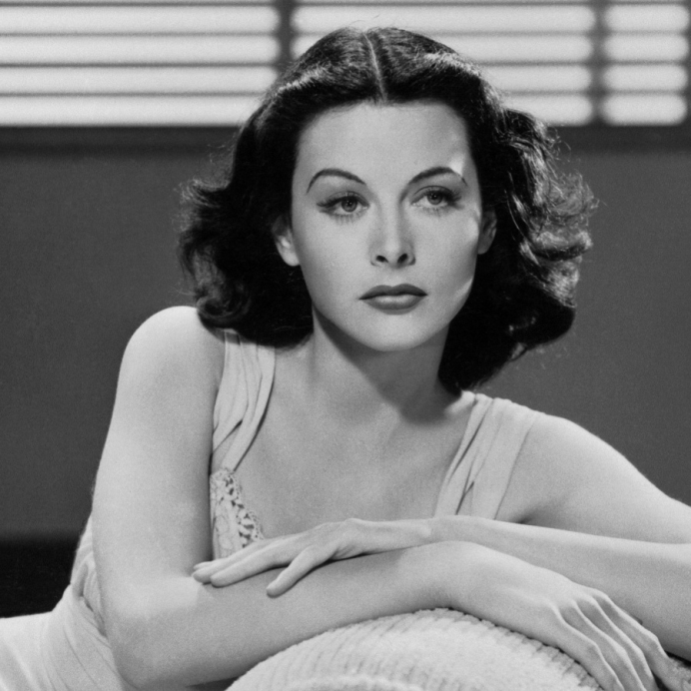
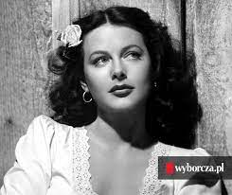
3. Hedy Lamarr

Slide 17
Hedy Lamarr
It involved manipulating radio frequencies with unbreakable code to prevent the enemy from intercepting secret messages. The device she invented with George Antheil was supposed to be used against the Nazis during World War II, but in fact it came into use 20 years later.

Slide 18
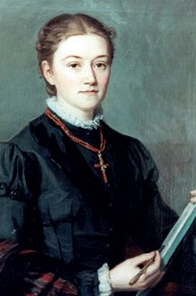
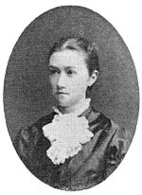
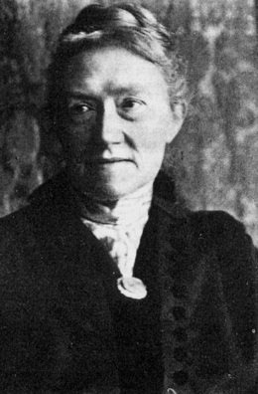
2. Agnes Pockels

Slide 19
Agnes Pockels
Agnes Pockels started her experiments with surface layers at the age of 18 in her home kitchen, initially inspired by the formation of foam and surface films on dirty water during washing dishes. She was not able to publish the results of these experiments until 1891, when she wrote to Lord Rayleigh, who had a translation of her letter published in Nature. In it, she described her measuring device (an early version of the Langmuir-Blodgett bath), which allowed the study of the relationship between surface tension, layer thickness and the presence of impurities, and the results obtained with it.

Slide 20
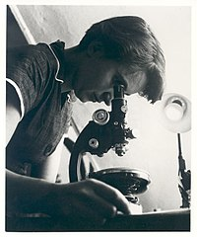
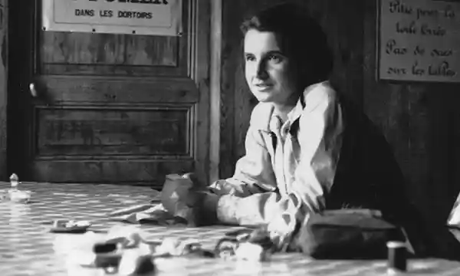
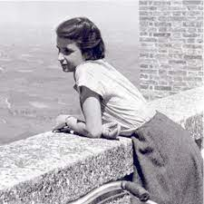
1. Rosalind Franklin

Slide 21
Rosalind Franklin
Her great achievement was the improvement of the structural x-ray technique.
Using this method, she captured the sodium salt of DNA, which became the starting point for research on the structure of DNA by James Watson and Francis Crick.
The problem is that her work went to Watson and Crick without her knowledge or consent, a decision made by Maurice Wilkins, who won the Nobel Prize for his discovery of the DNA double helix.
After receiving the award, the men admitted that without its photos and descriptions, they would not have created the correct model.

Slide 22
Thank you for your attention ☺

